Slide 1
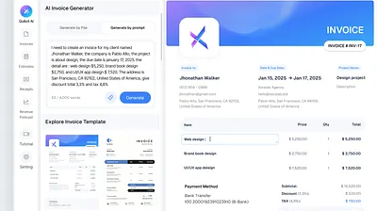
Invoice Management
System (IMS)
Automated Invoice Handling & Smart Email Notifications
Project Type
Key Feature
Full-Stack Web Application
Automated Email System

Slide 2
PROJECT OVERVIEW
Understanding the IMS
What is IMS?
Project Objectives
A comprehensive web-based solution designed to streamline invoice processing, tracking, and management through automation and intelligent notifications.
1
Automate invoice creation, storage, and retrieval
2
Implement intelligent due date tracking system
3
Build automated email notification framework
Web Application
Full-Stack
Modern Stack
4
Ensure secure user authentication and data protection
Problem Statement
Manual invoice handling is time-consuming and error-prone
Difficulty tracking due dates leads to missed payments
Key Highlight
No automated reminders cause payment delays
Automated Email Notification System
Lack of centralized invoice storage and management
Login Confirmation
Due Date Reminders

Slide 3
WATERFALL MODEL - PHASE 1
01
Requirement Analysis
User Requirements
Functional Requirements
Non-Functional Requirements
Admin Role
User Login & Authentication
Manage all invoices
Secure login with email/password using Auth.js
User account management
Security
Invoice Creation & Storage
Encrypted authentication, secure API endpoints, data protection
System configuration
Full CRUD operations with database persistence
User Role
Due Date Tracking
Automated tracking and status updates
Create & manage own invoices
View invoice history
Automated Email System
Performance
Receive email notifications
Smart notifications at scheduled intervals
Fast response times, optimized database queries
Scalability
Cloud-based architecture, horizontal scaling support

Slide 4
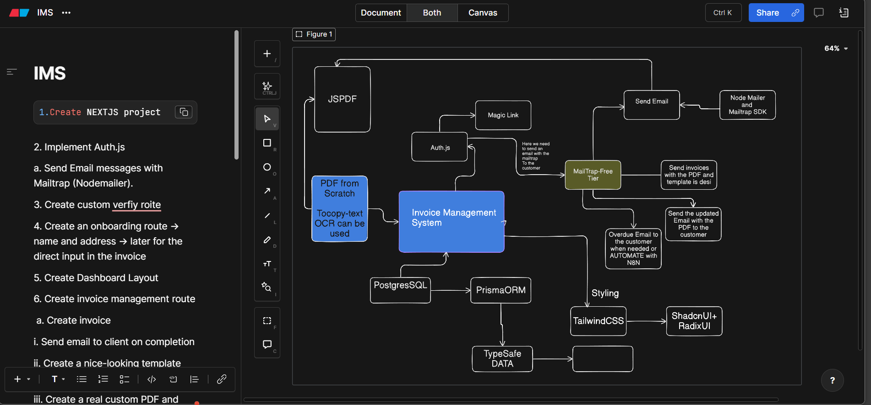
WATERFALL MODEL - PHASE 2
02
System Design
Technology Stack
Next.js
Full-Stack Framework
Tailwind CSS
Styling
Shadcn/UI
UI Components
Prisma + Neon
Database
Auth.js
Authentication
Google Gmail API
Email Testing
Database Design
Vercel
Deployment
Users
Invoices
Email Logs
Auth & Profile
Invoice Data
Notification History

Slide 5
WATERFALL MODEL - PHASE 3
03
Implementation
Login & Authentication
Email Automation Logic
Auth.js Integration
Login Confirmation
Secure credential-based authentication
Welcome email sent immediately after successful login
Session Management
JWT tokens with secure storage
Due Date Reminders
Role-Based Access
Admin and user permissions
3
Days before due date
1
Day before due date
0
On due date
Invoice CRUD Operations
Create
Read
Add new invoices
View invoice details
Security & Validation
Update
Delete
Zod Validation
Prisma ORM
Modify invoices
Remove invoices
Form data validation and type safety
Type-safe database queries

Slide 6
WATERFALL MODEL - PHASE 4
04
Testing
Unit Testing
Functional Testing
Validation Tests
Component rendering tests
End-to-end user flows
Function logic validation
Invoice CRUD operations
Login Validation
API endpoint testing
Authentication workflows
Valid credentials acceptance
Database query tests
Role-based access control
Invalid credentials rejection
Session timeout handling
Email Testing with Mailtrap
Invoice Validation
Required field validation
Date format verification
Email Capture
Content Verify
Debug Issues
Amount validation
Intercept emails
Check templates
Fix email bugs
Error Handling & Bug Fixing
Identify
Fix
Retest
Deploy

Slide 7
05-06
WATERFALL MODEL - PHASE 5 & 6
Deployment & Maintenance
Deployment
Future Scope
Vercel Platform
PDF Invoice Export
Serverless Deployment
Generate downloadable PDF invoices with professional formatting and branding options.
Automatic CI/CD pipeline
Global CDN distribution
Instant rollback capability
Payment Gateway Integration
Enable online payments through Stripe, PayPal, or other payment processors.
Neon Database
Cloud PostgreSQL
Dashboard Analytics
Serverless PostgreSQL
Visual charts and reports for invoice statistics, payment trends, and financial insights.
Auto-scaling storage
Branching for dev/test
Mobile Application
Native mobile apps for iOS and Android for on-the-go invoice management.
Maintenance Activities
Bug Fixes
Template Updates
Enhancements
Issue resolution
Email design
New features

Slide 8
Thank You

